Slide 1
BLOOD GROUPS AND BLOOD TRANSFUSION
DR.Deepa.G.S
Assistant professor
Dept.of Physiology
Skhmc,Kulasekharam

Slide 2
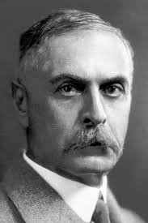
Blood group systems
ABO group-Landsteiner-1901
MN group-Landsteiner and
Levine- 1927
Rh group-Landsteiner and Weiner -1940
Other-Lewis,Kidd,Duffy
https://www.google.com/search?q=karl+landsteiner&safe=active&sxsrf

Slide 3
Blood group or blood type is determined by the presence or absence of inherited antigenic substances on the surface of Red blood cells
These antigens may be proteins, carbohydrates, glycoproteins or glycolipids based on blood group system

Slide 4
Antigen and antibody
Agglutinogens or Antigens present in cell membrane of RBC
Antigen A
Antigen B
Agglutinins or Antibodies are present in Serum
α - anti A
β - anti B

Slide 5
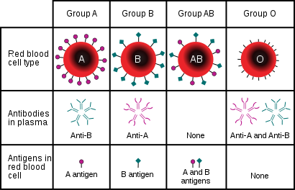
ABO system
https://www.google.com/imgres?imgurl=https%3A%2F%2Fupload.wikimedia.org

Slide 6
Antigens
Complex oligosacharides
First appearance-Sixth week of foetal life
At birth-1/5th of adult
Found in other organs like Salivary glands, pancreas, kidney,liver,lung and testis
80% of secretors-Gastric juice,saliva and other body fluids

Slide 7
Antibodies
Gammaglobulins –IGM type usually
At birth-nil
Ten years-Maximum concentration then decreases

Slide 8
Percentage of population having different blood groups
https://www.google.com/imgres?imgurl=http%3A%2F%2Fwww.ajts.org

Slide 9
Inheritance of blood groups
Depends on three genes A,B,O in the ninth pair of chromosome – A and B are dominant
Bombay blood groups groups-No antigen A,B or H

Slide 10
Inheritance of blood group
Genotype | Blood types
OO | O
OA | A
AA | A
OB | B
BB | B
AB | AB

Slide 11
Rh group
Rh antigens-C,D.E,c,d,e
D-most common and immunogenic
Presence of D antigen-Rh^{+ve}
Absence of D antigen- Rh^{-ve}
Present only in RBC
No natural antibodies
Antibodies of IgG formed when Rh^{+ve} blood transfused to Rh^{-ve} person

Slide 12
Inheritance of Rh group
Rhesus factor is an inherited dominant
DD-Rh^{+ve}
Dd-Rh^{+ve}
dd-Rh^{-ve}

Slide 13
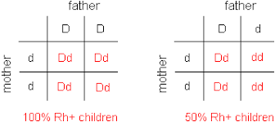
Rh inheritance
https://www.google.com/imgres?imgurl=https%3A%2F%2Fwww2.palomar.edu

Slide 14
Blood transfusion
Donor-One who donates blood
Recipient-One who receives blood
Universal Donor- ‘O’ group
Universal recipient- ‘AB’ group

Slide 15
Blood transfusion
Age of donor -18-60 years
Weight-45Kg
Minimum interval for donation-3 months
Blood volume restores in 24 hours
Hb restores in 2 weeks

Slide 16
Blood transfusion
Procedure
Blood collected form vein of donor under sterile condition in a bottle containing a solution of sodium citrate and glucose
Used at once or stored at 4º C
Storage period- five weeks
One unit of whole blood contains
450 ml of blood
63ml of anticoagulant
Preservative- citrate,phospate dextrose

Slide 17
Precautions before blood transfusion
Donor should be healthy
Compatibility tests should be done
Direct cross matching- sure safe guard against transfusion complications.
Match the serum of the recipient directly against cell of donor
Transfusion rate in adult-100-200ml/hour
Too rapid transfusion is dangerous

Slide 18
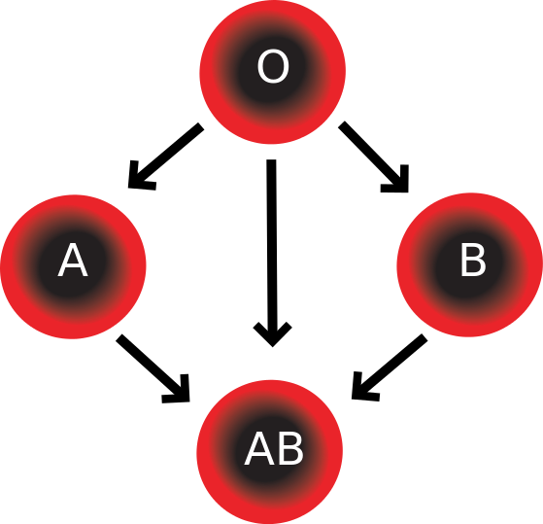
Blood group compatibility
google.com/imgres?imgurl=https%3A%2F%2Fupload.wikimedia.org

Slide 19
Blood group compatibility
Cells of Donor | Serum of recipient
 | O Anti A&B | A Anti-B | B Anti-A | A&B Nil
O | - | - | - | -
A | + | - | + | -
B | + | + | - | -
AB | + | + | + | -

Slide 20
Matching and cross matching
Blood matching or typing-
To determine the blood group
Recipients RBC + test sera
Cross matching
To determine whether the Recipients body will accept the donor’s blood
Recipient’s serum + Donor’s RBC

Slide 21
https://www.google.com/imgres?imgurl=https%3A%2F%2Flaboratoryinfo.com

Slide 22
ABO incompatibility
Signs and symptoms
Non-hemolytic transfusion reaction develops within few minutes to hours
Fever
breathing difficulty
itching

Slide 23
Hemolytic transfusion reaction
Acute
Fever, chill, increased heart rate, low Bp, shortness of breath, nausea, vomiting,chest pain
Delayed
Jaundice
Cardiac shock
Renal shutdown-anuria
Death within 10-12 days if not managed

Slide 24
google.com/imgres?imgurl=https%3A%2F%2Fimage.slidesharecdn.com

Slide 25
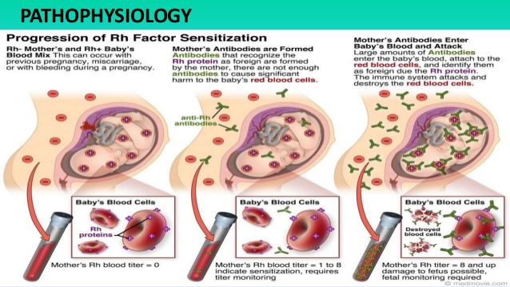
https://www.google.com/imgres?imgurl=https%3A%2F%2Fimage.slidesharecdn.com

Slide 26
complications
Severe anemia
Hydrops foetalis
Kernicterus
https://www.google.com/imgres?imgurl=https%3A%2F%2Fimage.slidesharecdn.com

Slide 27
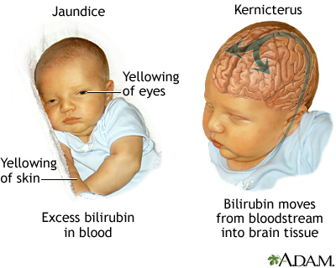

Slide 28
Bombay blood group
In 1952 some Marathi speaking people around Bombay were reported to have RBC blood group antigens designated as Bombay blood group and symbolized as oh
Antigen –A,B,H absent
Antibodies-A,B,H
H antigen –precursor of A B antigen and present in RBC of all individuals usually

Slide 29
Importance of blood grouping
Blood transfusion and in tissue transplantation
To prevent Rh incompatibility during pregnancy

Slide 30
Blood transfusion
Conditions
Anemia
Haemorrhage
Trauma
Burns
Surgery

Slide 31
Hazards
Transfusion reactions
ABO incompatibility
Rh incompatibility
Due to massive transfusion
Circulatory shock
Hyperkalemia
Hypocalcemia
Hemosiderosis

Slide 32
Due to Faulty techniques
Thrombophlebitis
Air embolism
Transmission of infections
HIV
Hepatitis B,A
Glandular fever
Herpes
Bacterial infections

Slide 33
Blood substitutes
Human plasma
0.9%sodiumchloride
Colloids like
Gum accacia
Isingglass
Dextran

Slide 34
Exchange transfusion
Replacement transfusion
Indications
Erythroblastosis foetalis
Sickle cell anemia
Severe polycythemia
Toxicity of drugs
Severe jaundice

Slide 35
Procedure
5-20ml blood drawn out
Equal quantity fresh prewarmed blood or plasma-infused
Repeat the procedure within few hours till the whole of predetermined volume of blood exchanged

Slide 36
Thank you

